Slide 1

Data Engineering 2
Nimish bhatt rohan Kulkarni siddharth tapre

Slide 2
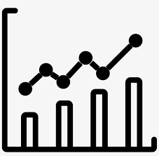
Introduction
stock market trading is a huge industry and plays a crucial part in the flow of money as well as affects the business and people involved in it.
Obtaining data and visualizing it in real-time is crucial to take decisions required for trading.
new data is generated every microsecond. Obtaining, processing & storing it effectively and consistently is a challenging task
Thus, using various tools, we have created a data pipeline to solve the problem.

Slide 3

User Story
The user should be able to obtain data on the stock market in real-time.
Visuals should also be generated in real time.
The gathered data should be stored long-term, preferably on the cloud, and be able to access later.

Slide 4
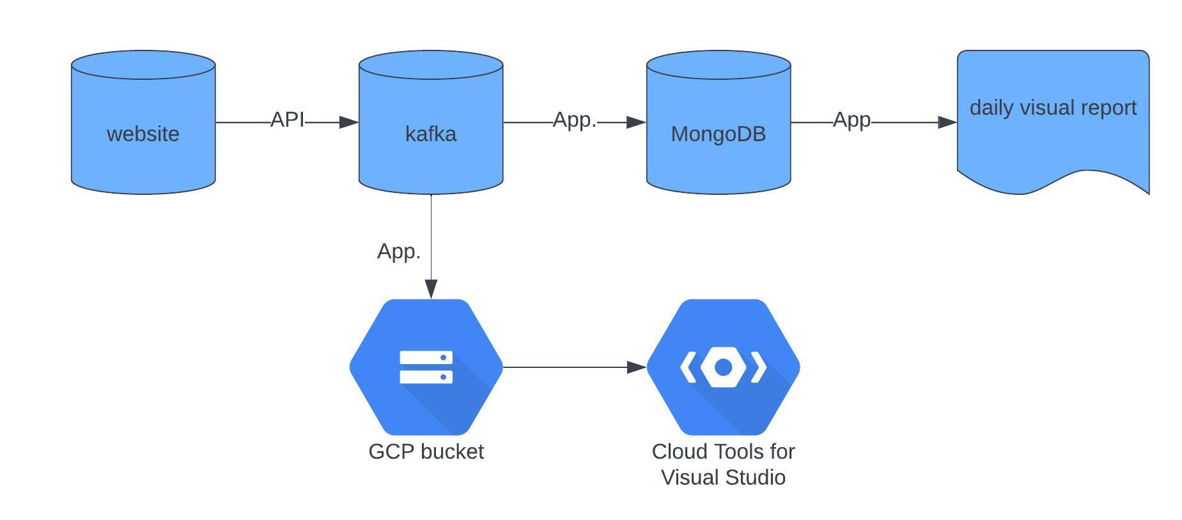
Diagram of data pipeline

Slide 5

Benefits of the Pipeline
The data is stored in MongoDB for further visualization, this helps effective access to data with reduced latency.
The data is also stored directly in GCP using Kafka for long-term storage.
The visualization is done on a local server containing short-term data

Slide 6
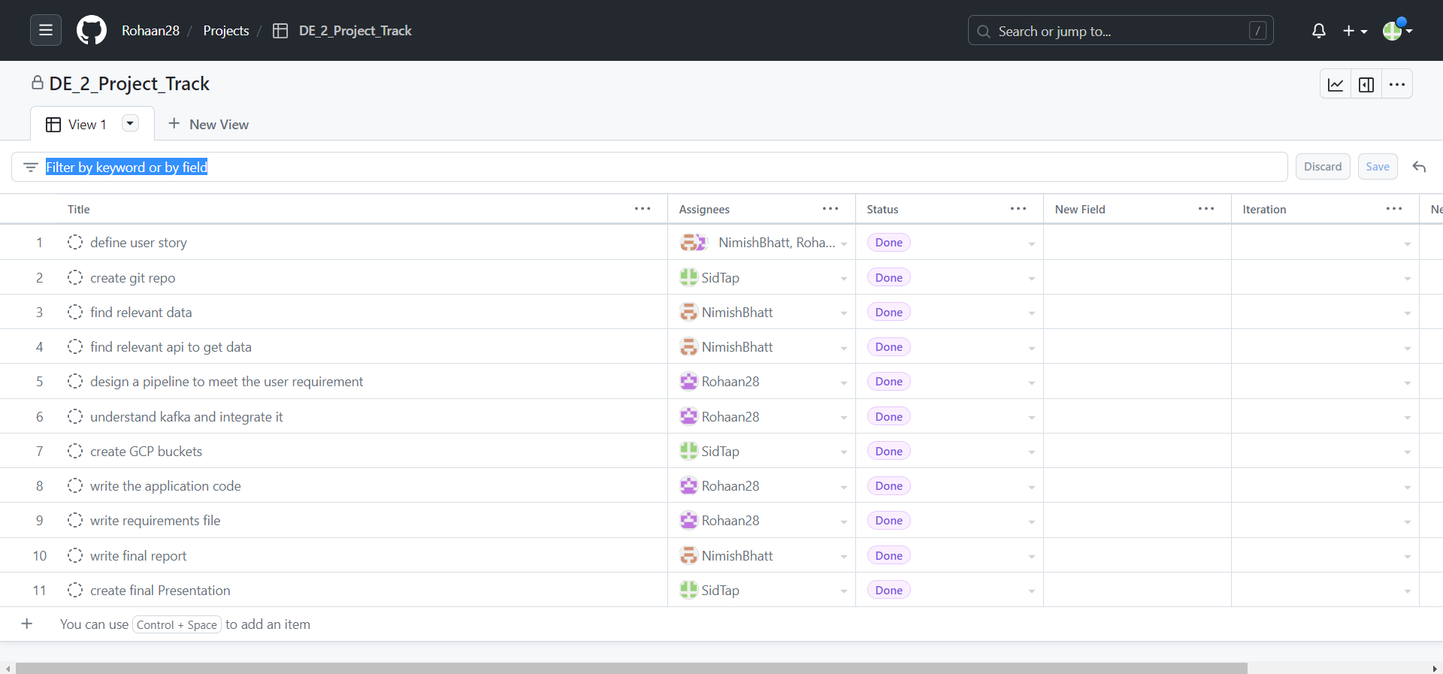
KanBan board

Slide 7

limitations
Currently we are obtaining only ‘Uber’ data. If required changes can be made in the app to get other company’s data
Any change made by the website on previous data will be considered as actual data, previous versions of the data cannot be retrieved.
The visuals created are predetermined and not interactive. Any other kind of visualization will require changes in the code.

Slide 8

Requirements
We have created a virtual environment for this project based on Python 3.9
All the packages that are required to run the code are mentioned in the requirements.txt file which is uploaded on Git Hub.
Example. Pandas, Plotly, Kafka etc.
The entire application has been developed on VS code

Slide 9

Difficulties
There was difficulty in specifying the correct set of parameters inside the Kafka producer object.
There was difficulty in establishing a connection with the Google Cloud using Python.
There was difficulty in rendering the visuals live.

Slide 10

Let’s go to Git hub to understand the code

Slide 11

Thank you and auf wiedersehen

